Slide 1
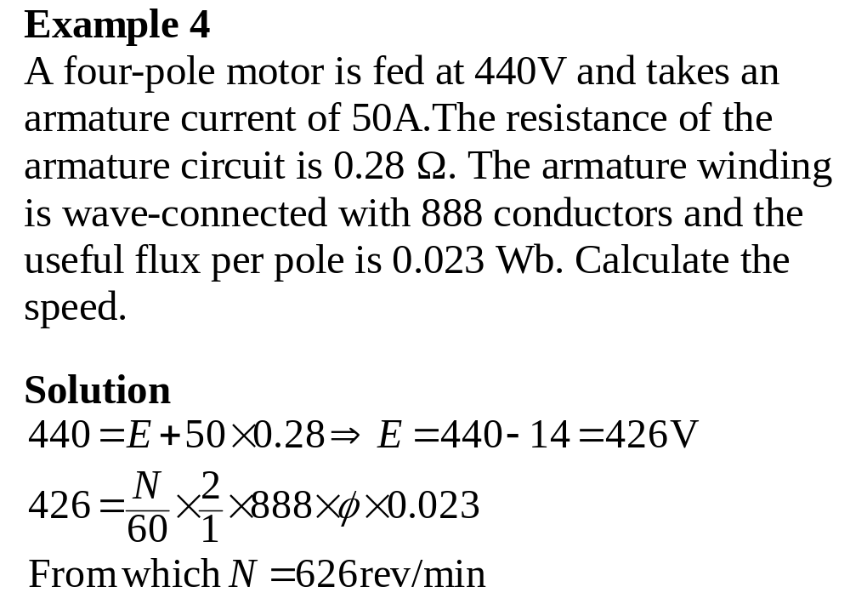

Slide 2
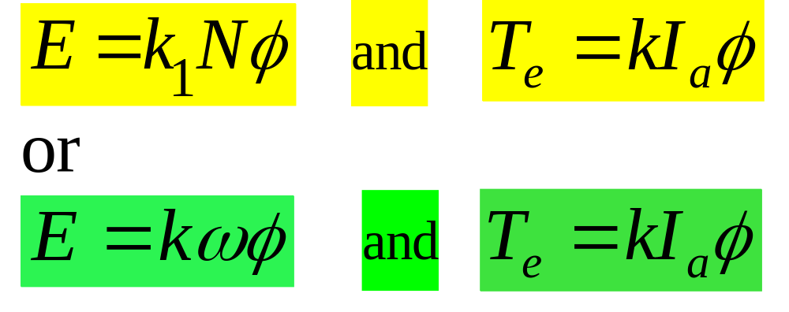
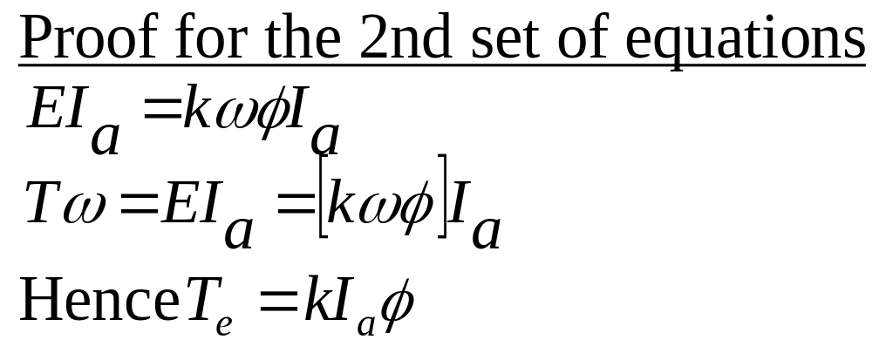
Basic equations of dc machines

Slide 3
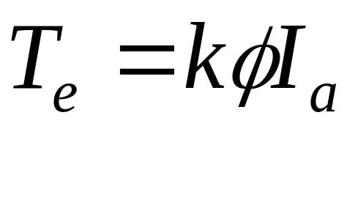
Load characteristics of D.C. motors
Electromagnetic torque characteristic
It shows the variation of T_{e} with armature current.
The shape of the curve can be deduced from the fundamental torque equation:

Slide 4
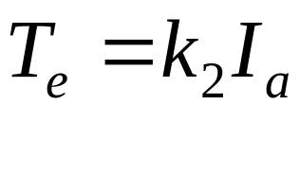
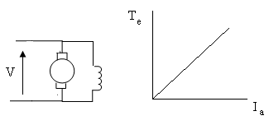
Electromagnetic torque characteristic cont’d
Shunt motor
The flux is constant for a given applied voltage.
Therefore the torque equation is in the form,
This is a linear relation

Slide 5
Electromagnetic torque characteristic cont’d
Shunt motor cont’d
The curve obtained when the applied voltage is
the rated voltage is termed the basic
electromagnetic torque characteristic
Series motor
When the magnetic circuit is not saturated flux is proportional to I_{a} and when saturated, flux is constant.

Slide 6
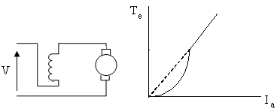
Electromagnetic torque characteristic cont’d
Series motor cont’d
Hence the initial portion of the torque-armature curve will be a parabola and ultimately it will merge into a straight line passing through the origin.

Slide 7
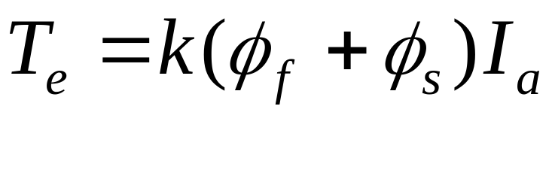
Electromagnetic torque characteristic Cont’d
Compound motor
The basic torque equation is
The characteristic depends on the relative strengths of the two components
On the next slide T_{e}-I_{a} curves of dc motors having the same voltage, power and speed ratings are compared

Slide 8
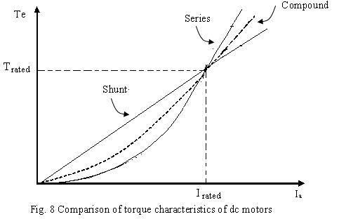
Load characteristics of D.C. motors

Slide 9
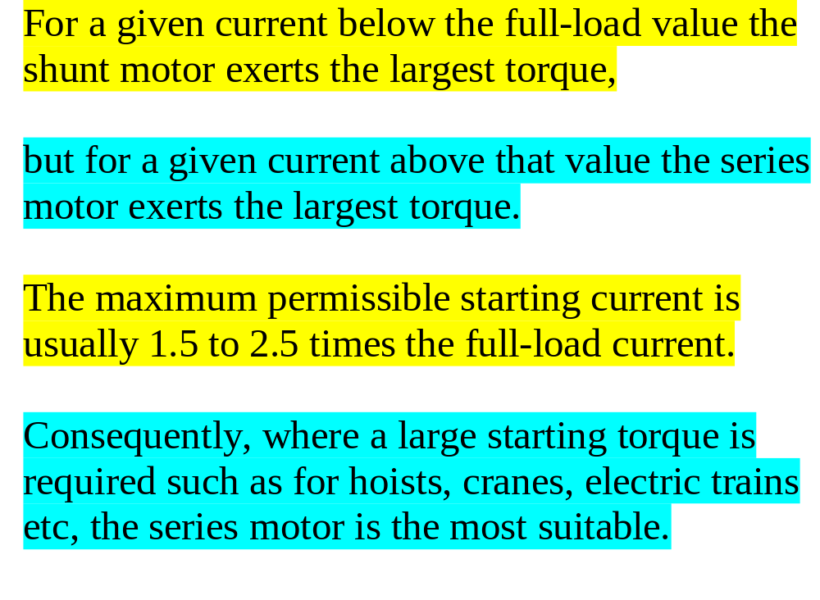

Slide 10
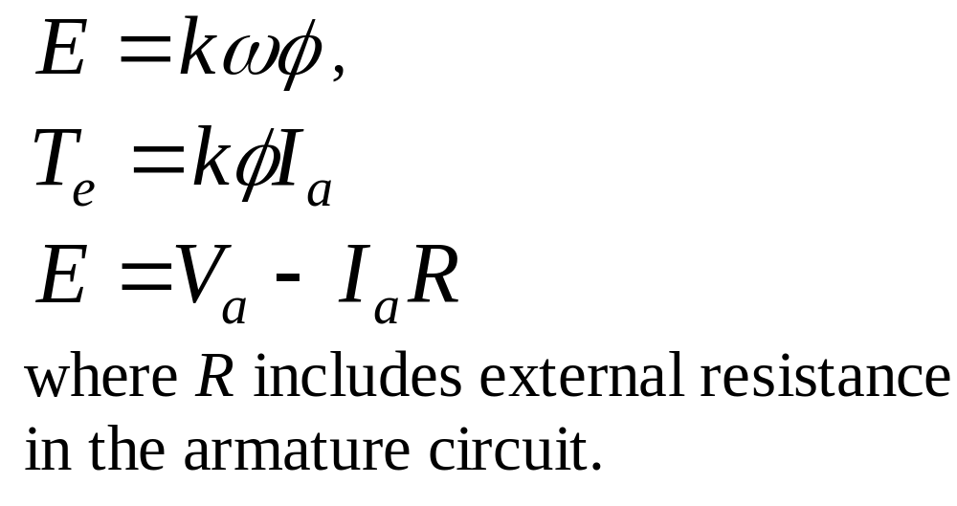
Load characteristics of D.C. motors
Speed-torque characteristics
These characteristics can be derived from
the two basic equations and
the armature circuit voltage equation:

Slide 11
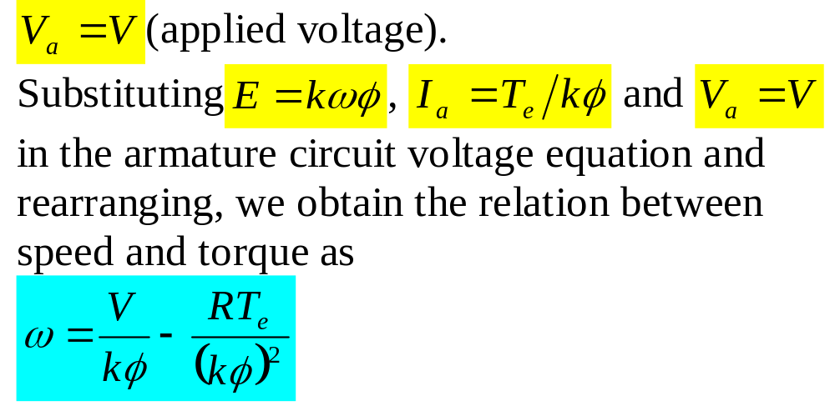
Speed-torque characteristics
Shunt motor
The speed-torque curve is shown on the next
slide

Slide 12
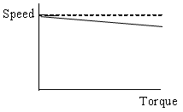
Speed-torque characteristic of the shunt
motor

Slide 13
ω-T_{e} curve of the shunt motor cont’d
The difference between no-load and full-load speeds has typical values around 5% of full-load speed
[In small machines the values are higher (10 – 15%)].
Consequently, the dc shunt motor is considered to be a constant speed drive.
A typical application is the lathe machine which requires constant speed and low starting torque.

Slide 14
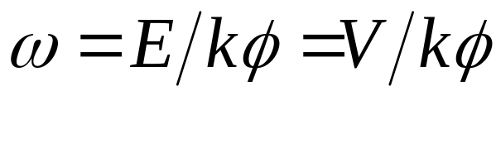
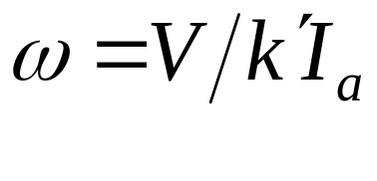
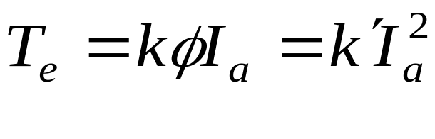
ω-T_{e} characteristic of dc series motor
If the resistance in the armature circuit is neglected then V = E. Hence
Neglecting also saturation, it becomes
The torque equation

Slide 15
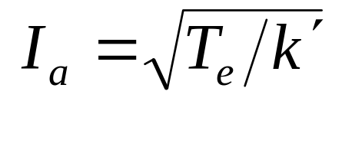
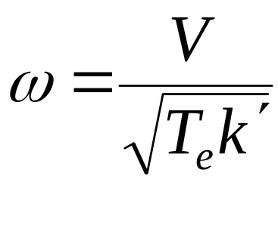
ω-T_{e} characteristic of dc series motor cont’d
Hence
Substituting this for I_{a} in the speed equation leads to the following relation between speed and torque:
The curve is shown on the next slide

Slide 16
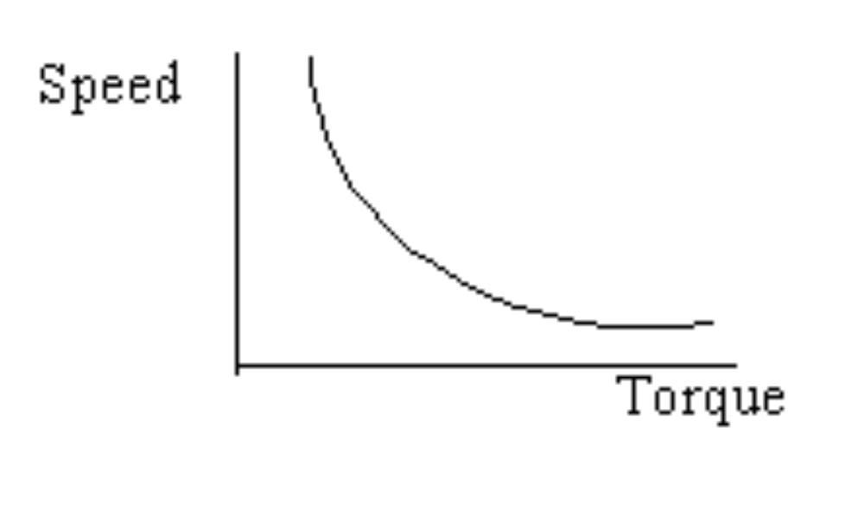
Speed-torque charateristic of dc Series motor

Slide 17
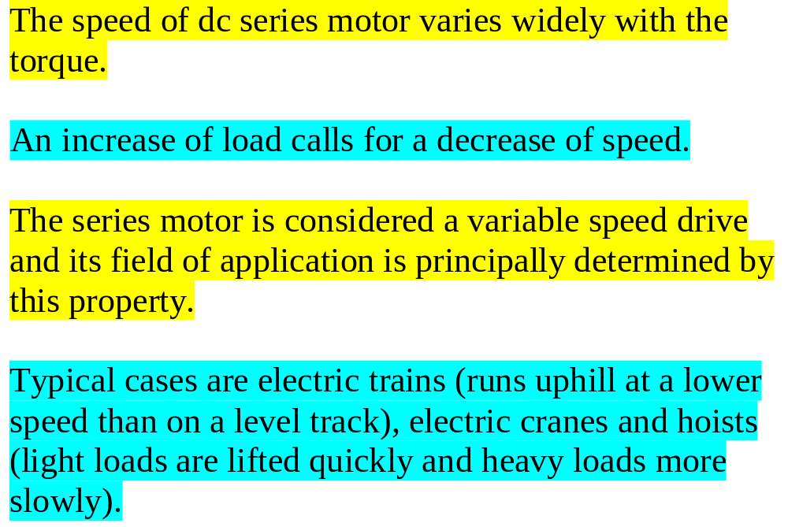
Speed-torque charateristic of dc Series motor

Slide 18
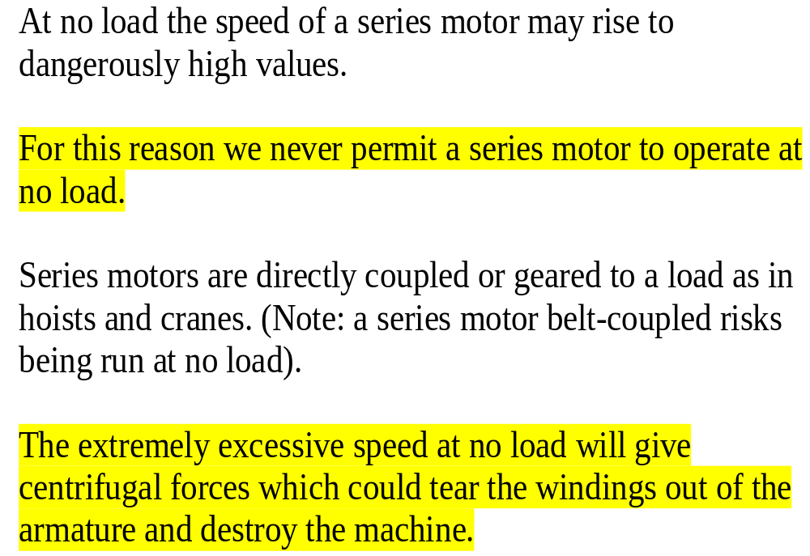

Slide 19
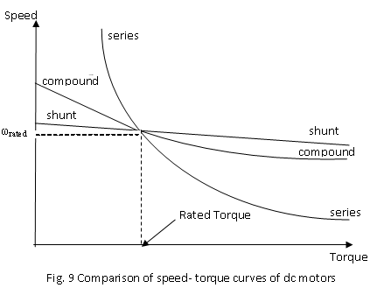
Comparing speed-torque curves of dc motors of
the same voltage, power and speed ratings

Slide 20
Cumulative compound motors are widely used for individual drives of certain machines (e.g. lifts, winches etc) where a speed characteristic of the type possessed by the series motor is required; with the exception that the no-load speed must be limited to a safe value.
The speed drop from no load to full load is generally between 10 and 30 %

Slide 21
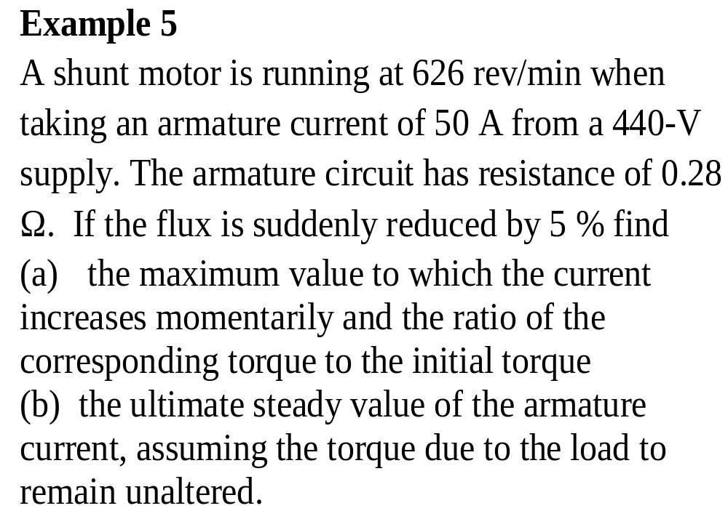

Slide 22
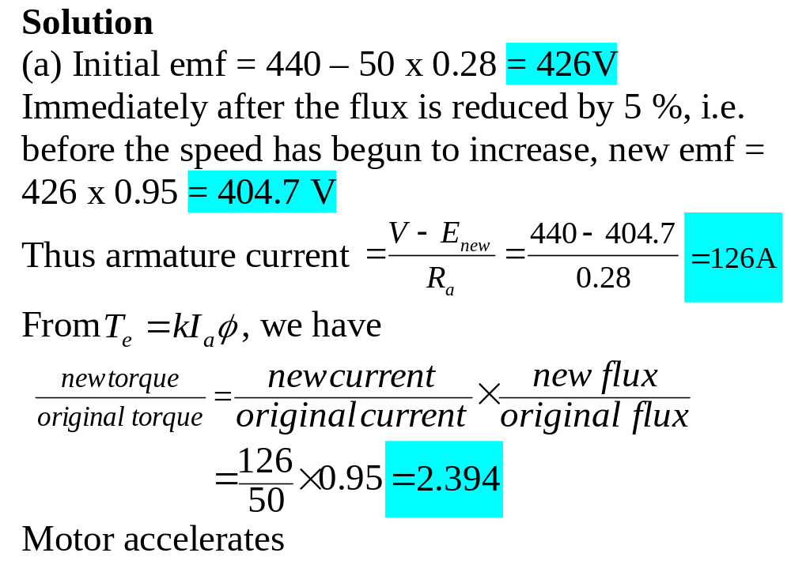

Slide 23
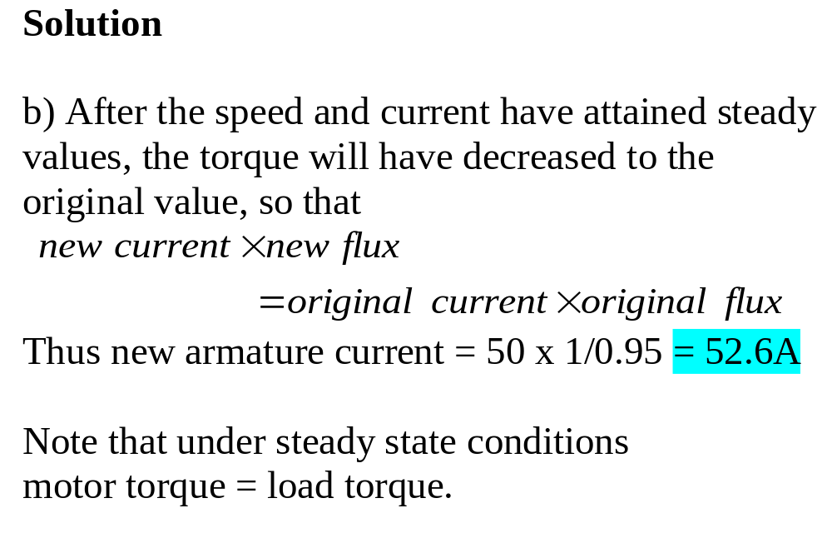

Slide 24
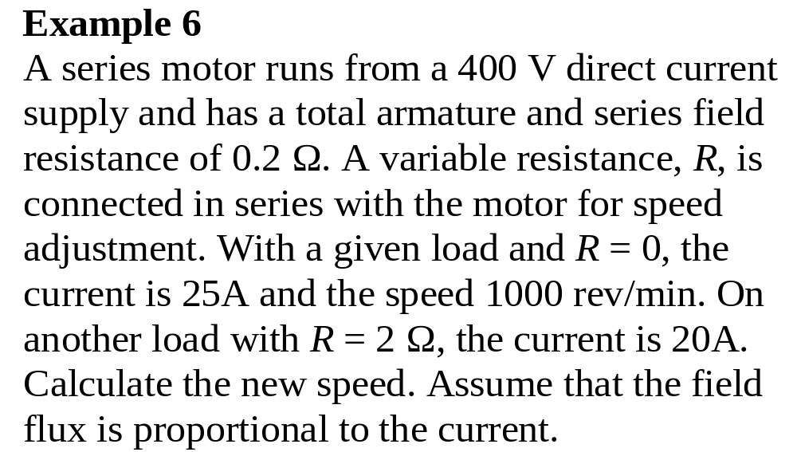

Slide 25
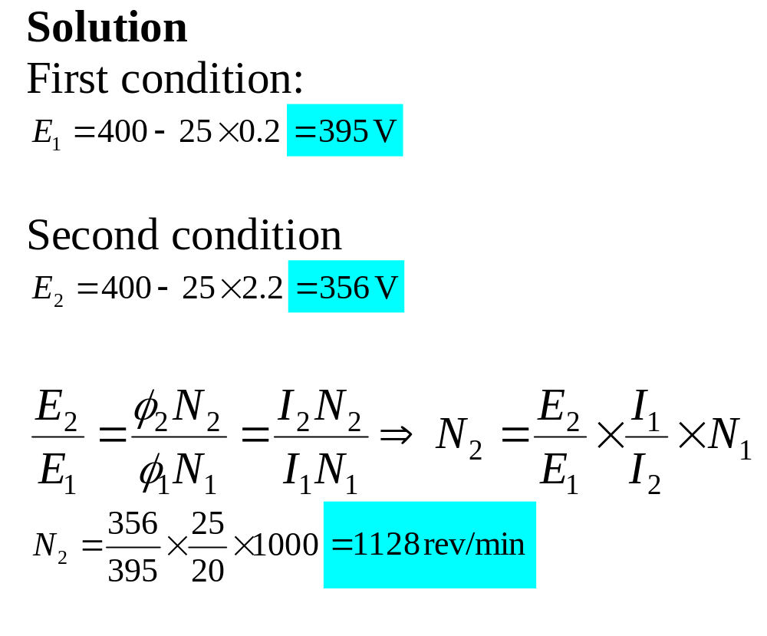

Slide 26
Example 7
A shunt motor, which has a field resistance of 200 Ω and an armature resistance of 0.8 Ω, takes 26 A from a 200 V supply when running at 500 rev/min on full load. In order to control
the speed of the motor a 1.2-Ω resistor is connected in series with the armature. Calculate the speed at which the motor will run when supplying full-load torque.

Slide 27
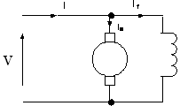
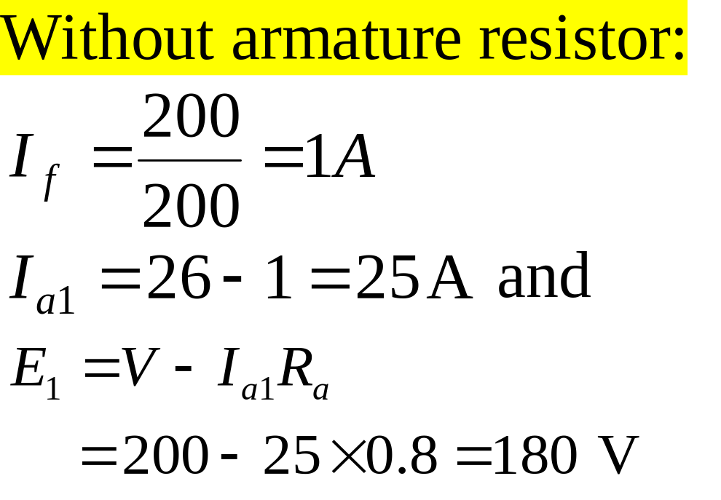

Slide 28
